Slide 1
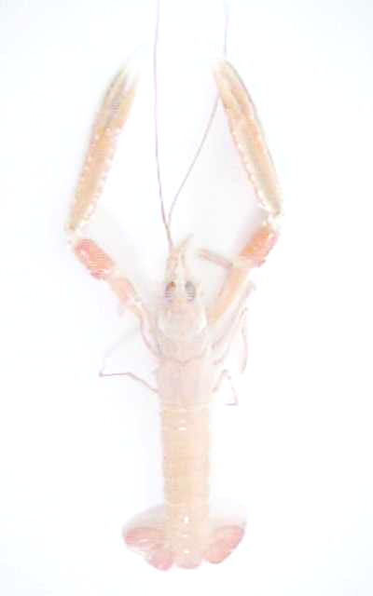
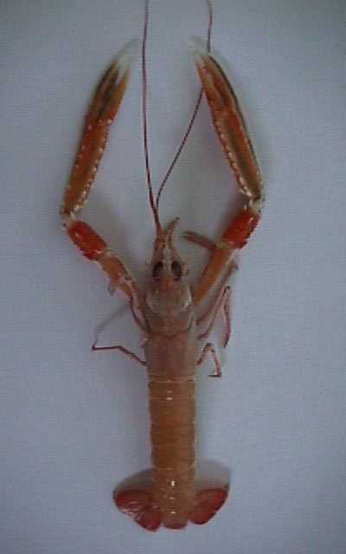
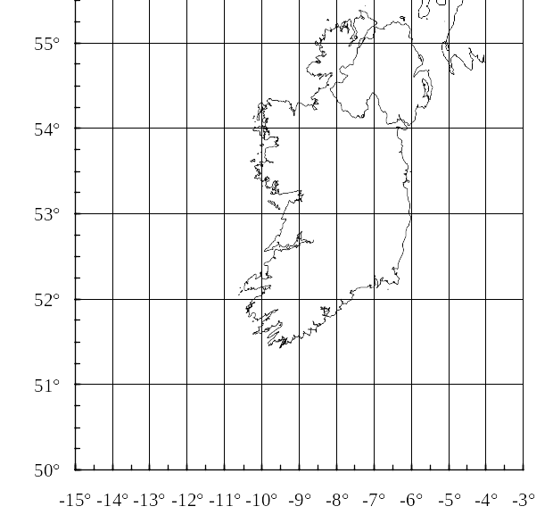
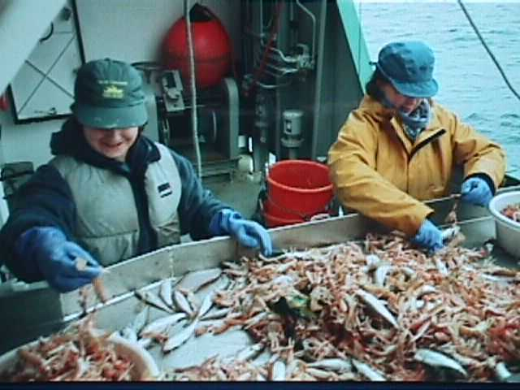
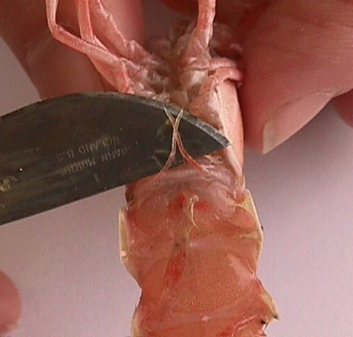
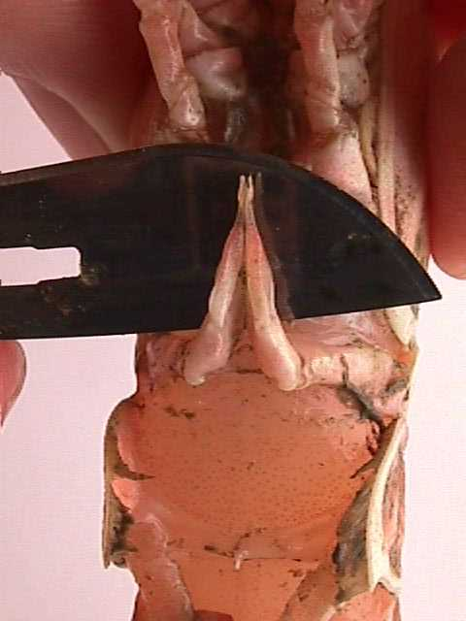
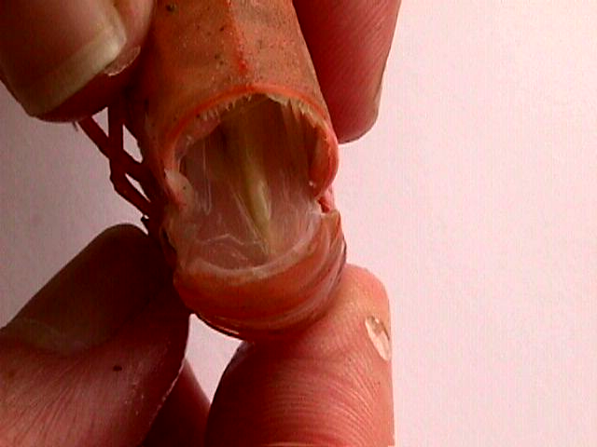
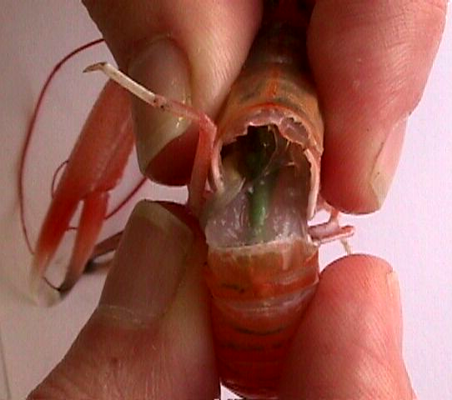

The Dublin Bay Prawn
The Norway Lobster /
Nephrops norvegicus
Nephrops norvegicus is a valuable marine species, worth approximately £13 million per annum to the Irish commercial fishery.
It is necessary to regularly monitor the Nephrops fishery. One way the Marine Institute, Dublin does this is by conducting surveys using the Irish research vessel, the R.V. Celtic Voyager.
Western Irish Sea
Carapace Length
Porcupine Bank
Smalls Grounds
Labadie Bank
Cockburn Bank
What Happens During the Surveys ?
Nephrops norvegicus
The main Nephrops grounds around the Irish coast.
Hauls of 1.2 nautical miles are made using a standard prawn net of
80mm mesh.
Catch is sorted - all the Nephrops are removed from the catch and weighed.
Nephrops are individually measured - from the eye socket to the base of the thorax (carapace length).
Sex of each Nephrops is determined
Female maturity stage is determined - done by breaking apart the abdomen (tail) from the thorax (carapace) and observing the colour of the ovaries. These change from cream when immature to dark green when mature.
Data is recorded - analysed in the laboratory ashore.
Sorting the catch after the trawl.
What Happens to the Information Gathered?
The information recorded can indicate the state of the Nephrops stock. It is a good sign if there are a lot of older individuals and may mean that fishing pressure is low. If the population is made up of mainly young Nephrops, fishing pressure may be high as all the older ones are being fished out.
The data obtained on the research vessel is used for other purposes also. The Marine Institute is currently involved in an EU funded project to estimate the age structure of the Nephrops populations around the Irish coast - in partnership with Northern Ireland, Spain and France.
Female Nephrops. Note the very thin pleopods .
Male Nephrops.
Immature female Nephrops.
Mature female Nephrops (note the green ovaries).

